Slide 1
Microsoft's New
Movie Studio
Market Analysis and Strategic Recommendations

Slide 2
PROJECT SUMMARY
To identify current box office trends and translate these findings into three actionable business recommendations based on:
1
Data Collection and Analysis: Box Office Performance Trends: Genres: Analyze which genres have consistently performed well.
Themes: Identify popular themes and storylines.
Formats: Compare the performance of different formats (e.g., animated, live-action).
2
Competitive Analysis for successful Studio Strategies:
Content Portfolio: Study the mix of genres and formats in successful studios' portfolios.
Release Strategies: Analyze the timing and marketing strategies for top-performing films.
3
Consumer Insights - Audience Preferences:
Demographics: Break down preferences by age, gender, and region.
Feedback: Summarize key insights from surveys and social media analysis.

Slide 3
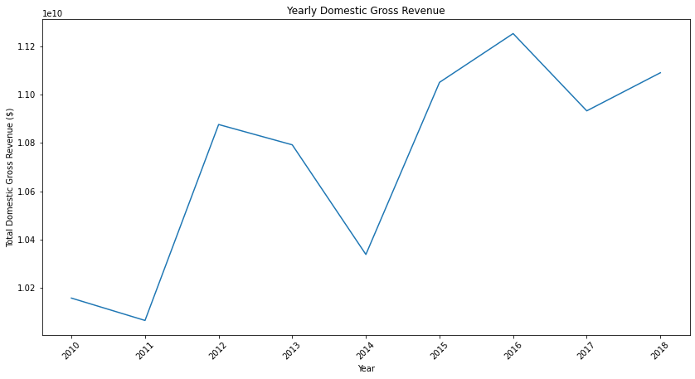
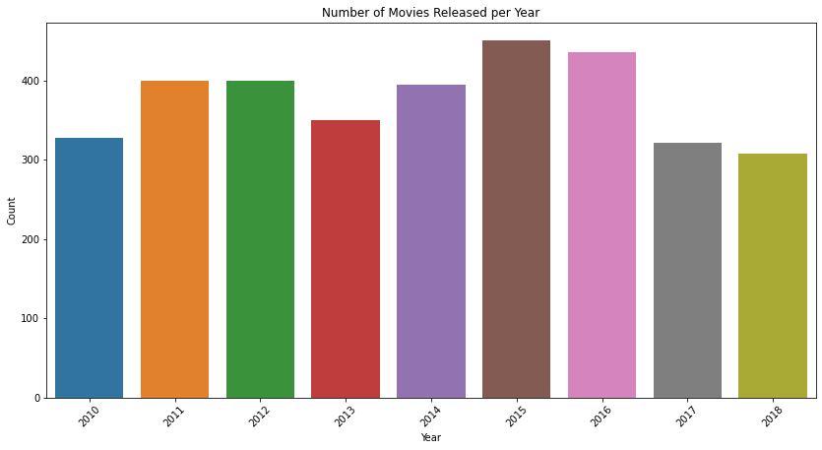
Movie REVENUES
Domestic Gross Revenue
There has been significant growth in revenues in the business from 2011 to 2018 indicating a viable business
Movies released per Year
The number of movies has been consistent despite fluctuation in the gross domestic revenue

Slide 4
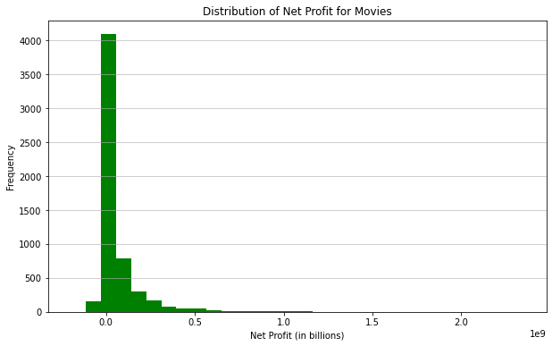
Profit:
The net profit distribution shows that the movie business rarely has losses over time.

Slide 5
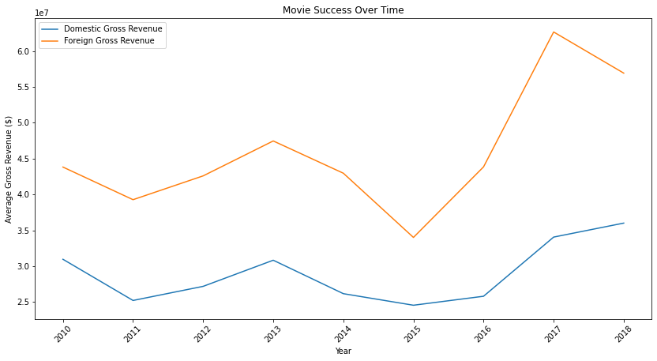
Time Trends:
Microsoft should consider expanding its movie releases globally to tap into international markets and maximize revenue potential. By releasing movies internationally, Microsoft can reach a larger audience and capitalize on the growing demand for content in global markets.

Slide 6
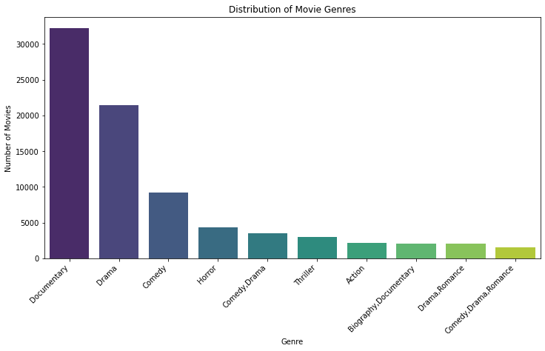
Genre-wise Analysis
Understand which genres perform best in terms of domestic and foreign gross revenue. From this Data, we need to produce documentaries, drama, comedy, horror and comedy-drama

Slide 7



PROJECT RECOMMENDATIONS
THE MOVIE BUSINESS IS VIABLE FOR INVESTMENT
Invest in High-Budget
Action and Adventure Films:
Develop a Balanced
Content Portfolio:
Implementation Planning
Monitoring and Adjustment:
Focus on
Younger Audiences:
Leverage Microsoft's technological expertise to create visually stunning, high-budget action and adventure films, catering to the strong audience demand in these genres.
Produce a mix of blockbuster films and critically acclaimed smaller projects. This strategy not only diversifies risk but also appeals to a broader audience base, ensuring steady revenue growth.
Adjust strategies based on real-time data and market changes.
Tailor marketing strategies and content development to target the 18-34 age demographic, emphasizing innovation, visual effects, and immersive storytelling experiences.

